Slide 1

Statistical Analysis of Basketball Players’ Performance for the NBA season of 2018-19 Author: Himesh Buch Submitted to: Lynn A. Agre, MPH, PhD Statistics 467/567 August 11, 2020

Slide 2
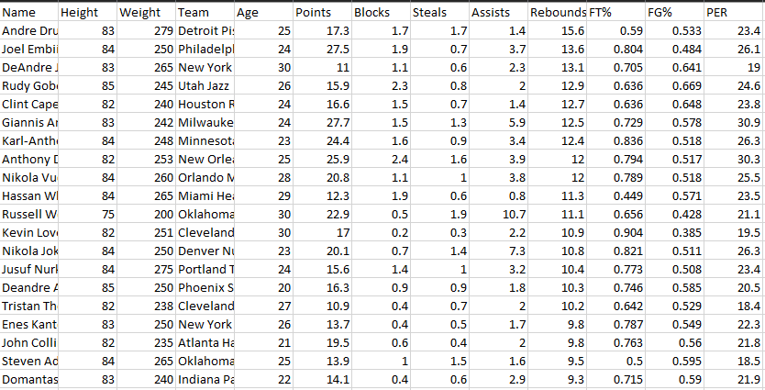
Overview
Data retrieved from Kaggle
It contains variables like points, blocks, assists, and steals per game, just to name a few
Here’s a quick snippet:

Slide 3
Understanding variables
Name: Player names (discrete, string)
Team: Team names (discrete, string)
Points: Point score by a player in a game (continuous, numeric)
Assists: Assists made by players per game (continuous, numeric)
Steals: Number of times the ball is stolen from the opposition in a game (continuous, numeric)
Blocks: Number of blocked shots in a game (continuous, numeric)
Rebounds: Getting possession after a failed shot (continuous, numeric)
FT%: Points earned from free throw line (continuous, numeric)
FG%: Points earned that are not FT and fouls (continuous, numeric)
PER: A widely used statistic to understand player’s efficiency (continuous, numeric)
Binary: All of the above, with a value of either 0 or 1 (continuous, numeric)

Slide 4
Hypothesis to be tested
Most valuable Player (MVP) of the 2018-19 NBA season
Best defensive player of the 2018-19 NBA season
What predictors help the most in determining above hypothesis?
Is Player Efficiency Rating (PER) a good factor for this analysis?

Slide 5
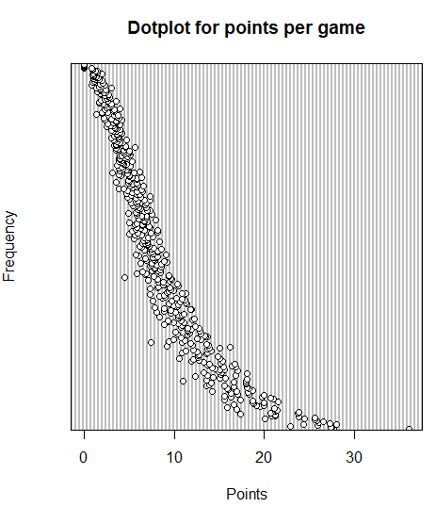
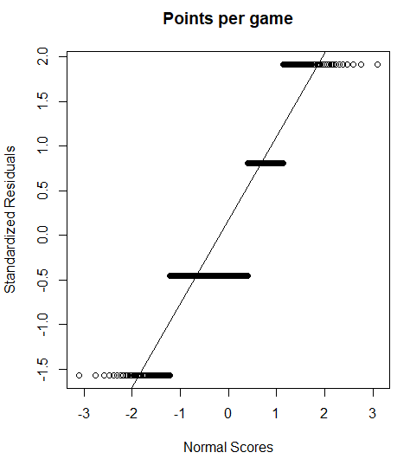
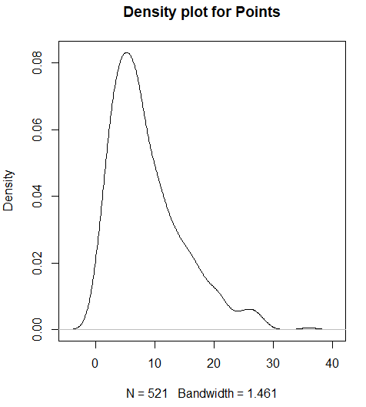
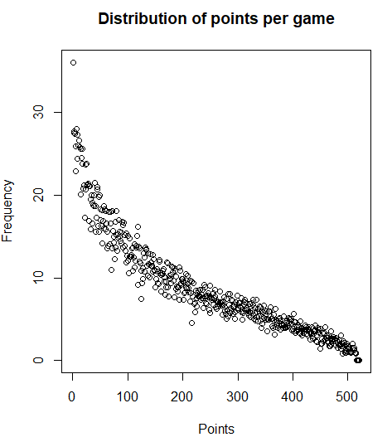
Methods used (Univariate Analysis)
Mean, Median, Mode, Frequency Count, Standard Deviation, Variance, Standard Error, Skewness (to understand data distribution)
Plots: Dot plot, Box plot, Normal Probability plot, Histogram, P-P plot, Scatterplot
Here are some plots:

Slide 6
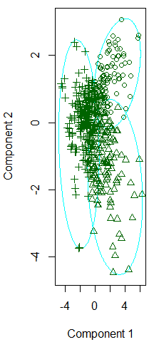
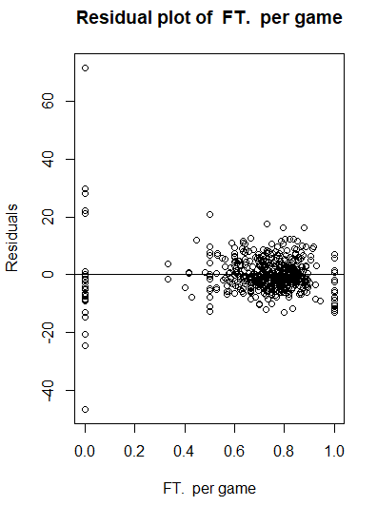
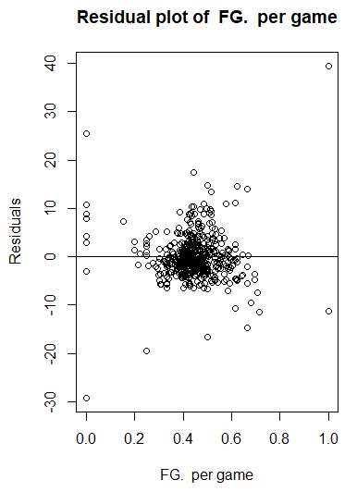
Methods used (Bivariate and Multivariate Analysis)
Transformation of variable, Hotelling T² CI, Variance-Covariance and Correlation matrix, eigenvalues and eigen vectors
MANOVA, Goodness of Fit Test, Residual Plots
Likelihood Ratio test, Forward Stepwise Regression
Classification Methods: K-means Cluster and Factor Analysis

Slide 7
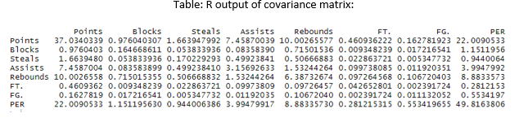
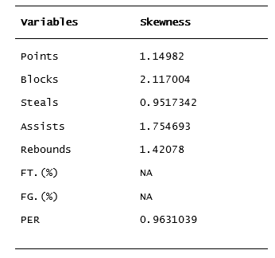
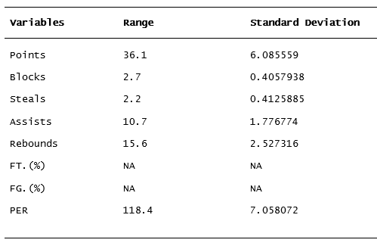
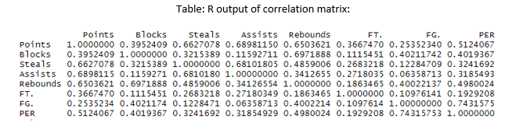
Tables

Slide 8
Results
Results suggest that formula for PER isn’t as affective (at least for this analysis)
Looking at the results of Forward Stepwise Regression (multivariable regression), PER prefers one variable over other
The formula proves above statement
Came up with a new formula and created a new column named “mvp_index”

Slide 9
Results
Using PER as a standard statistic puts Zhau Qi as the MVP, which by looking at his stats is no where close to the stats of the actual MVP
Using mvp_index to determine the MVP gives James Harden
Actual MVP of the season is Giannis Antetokounmpo who is at number two in the analysis using mvp_index and at number six using the PER
MVP Index of Giannis Antetokounmpo = 43.4528
MVP Index of James Harden = 48.9884

Slide 10
Results
Had to change formula to determine the Defensive Player of the season
Created a new column “defender_index” with the new formula
Actual Defensive Player of the season is Rudy Golbert, and according to the analysis it is Russell Westbrook
Defensive Index of Rudy Golbert = 17.92
Defensive Index of Russell Westbrook = 13.78

Slide 11
Discussion
Additional variables like different fouls, and blocks and rebounds missed are very important but missing
Other variables like Height, Weight, and Age could have been utilized
The main impact of the study is that the PER is not as efficient as it looks
The analysis overcame those limitations and answered the questions that could not be answered by PER and more

